Slide 1

Unit – 3 Parsing Theory (II)
Compiler Design (CD)
GTU # 2170701
Prof. Dixita B. Kagathara
Computer Engineering Department
dixita.kagathara@darshan.ac.in
+91 - 97277 47317 (CE Department)

Slide 2
Topics to be covered
Syntax directed definitions
Synthesized attributes
Inherited attribute
Dependency graph
Evaluation order
Construction of syntax tree
Bottom up evaluation of S-attributed definitions
L-Attributed definitions
Translation scheme

Looping

Slide 3
Syntax directed definitions

Slide 4
Syntax directed definitions
Syntax directed definition is a generalization of context free grammar in which each grammar symbol has an associated set of attributes.
The attributes can be a number, type, memory location, return type etc….
Types of attributes are:
Synthesized attribute
Inherited attribute
Value
Memory location
Type
E.
Return Type

Slide 5
Synthesized attributes
Value of synthesized attribute at a node can be computed from the value of attributes at the children of that node in the parse tree.
A syntax directed definition that uses synthesized attribute exclusively is said to be S-attribute definition.
Example: Syntax directed definition of simple desk calculator
Production | Semantic rules
L → E_{n} | Print (E.val)
E → E₁+T | E.val = E₁.val + T.val
E → T | E.val = T.val
T → T₁*F | T.val = T₁.val * F.val
T → F | T.val = F.val
F → (E) | F.val = E.val
F → digit | F.val = digit.lexval

Slide 6
Example: Synthesized attributes
String: 3*5+4n;
Production | Semantic rules
L → E_{n} | Print (E.val)
E → E₁+T | E.Val = E₁.val + T.val
E → T | E.Val = T.val
T → T₁*F | T.Val = T₁.val * F.val
T → F | T.Val = F.val
F → (E) | F.Val = E.val
F → digit | F.Val = digit . lexval
L
n
E.val=19
+
T.val=4
E.val=15
The process of computing the attribute values at the node is called annotating or decorating the parse tree
T.val=15
F.val=4
*
digit.lexval=4
T.val=3
F.val=5
F.val=3
digit.lexval=5
parse tree showing the value of the attributes at each node is called Annotated parse tree
digit.lexval=3
Annotated parse tree for 3*5+4n

Slide 7
Exercise
Draw Annotated Parse tree for following:
7+3*2n
(3+4)*(5+6)n

Slide 8
Syntax directed definition to translates arithmetic expressions from infix to prefix notation
Production | Semantic rules
L→E | Print(E.val)
E→E+T | E.val=’+’ E.val T.val
E→E-T | E.val=’-‘ E.val T.val
E→T | E.val= T.val
T→T*F | T.val=’*’ T.val F.val
T→T/F | T.val=’/’ T.val F.val
T→F | T.val= F.val
F→F^P | F.val=’^’ F.val P.val
F→P | F.val= P.val
P→(E) | P.val= E.val
P→digit | P.val=digit.lexval

Slide 9
Inherited attribute
An inherited value at a node in a parse tree is computed from the value of attributes at the parent and/or siblings of the node.
Symbol T is associated with a synthesized attribute type.
Symbol L is associated with an inherited attribute in.
Production | Semantic rules
D → T L | L.in = T.type
T → int | T.type = integer
T → real | T.type = real
L → L₁ , id | L₁.in = L.in, addtype(id.entry,L.in)
L → id | addtype(id.entry,L.in)
Syntax directed definition with inherited attribute L.in

Slide 10
Example: Inherited attribute
Example: Pass data types to all identifier real id1,id2,id3
D
Production | Semantic rules
D → T L | L.in = T.type
T → int | T.type = integer
T → real | T.type = real
L → L₁ , id | L₁.in = L.in, addtype(id.entry,L.in)
L → id | addtype(id.entry,L.in)
L
T
L.in=real
T.type=real
real
,
id
L₁
id3
L.in=real
,
id2
L.in=real
id
L₁
id
id1
L → L₁ , id
L → id
D→TL

Slide 11
Dependency graph

Slide 12
Dependency graph
The directed graph that represents the interdependencies between synthesized and inherited attribute at nodes in the parse tree is called dependency graph.
For the rule X→YZ the semantic action is given by X.x=f(Y.y, Z.z) then synthesized attribute X.x depends on attributes Y.y and Z.z.
The basic idea behind dependency graphs is for a compiler to look for various kinds of dependency among statements to prevent their execution in wrong order.

Slide 13
Algorithm : Dependency graph
for each node n in the parse tree do
for each attribute a of the grammar symbol at n do
Construct a node in the dependency graph for a;
for each node n in the parse tree do
for each semantic rule b=f(c₁,c₂,…..,c_{k})
associated with the production used at n do
for i=1 to k do
construct an edge from the node for C_{i} to the node for b;

Slide 14

Example: Dependency graph
Example:
E→E₁+E₂
Production | Semantic rules
E→E₁+E₂ | E.val = E₁.val+E₂.val
Parse tree
Dependency graph
val
E
E₁
E₂
val
+
val
$E.val$ is synthesized from $E1.val$ and $E2.val$
The edges to E.val from E₁.val and E₂.val shows that E.val is depends on E₁.val and E₂.val

Slide 15
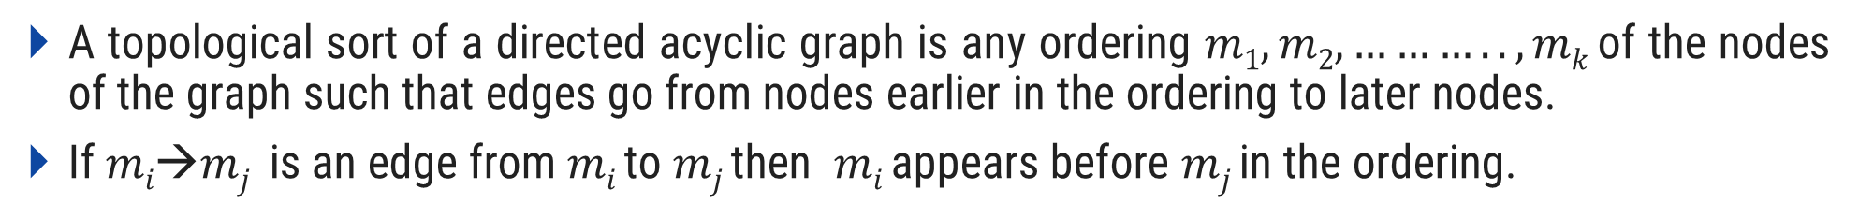
Evaluation order
A topological sort of a directed acyclic graph is any ordering $m1, m2,……….., mk$of the nodes of the graph such that edges go from nodes earlier in the ordering to later nodes.
If $mi→mj$is an edge from $mi$ to $mj$ then $mi$ appears before $mj$ in the ordering.
D
1
T.type=real
L.in=real
2
real
3
,
L.in=real
id3
4
,
id2
5
L.in=real
6
7
id1

Slide 16
Construction of syntax tree

Slide 17
Construction of syntax tree
Following functions are used to create the nodes of the syntax tree.
Mknode (op,left,right): creates an operator node with label op and two fields containing pointers to left and right.
Mkleaf (id, entry): creates an identifier node with label id and a field containing entry, a pointer to the symbol table entry for the identifier.
Mkleaf (num, val): creates a number node with label num and a field containing val, the value of the number.

Slide 18
Construction of syntax tree for expressions
Example: construct syntax tree for a-4+c
P1: mkleaf(id, entry for a);
P2: mkleaf(num, 4);
P3: mknode(‘-‘,p1,p2);
P4: mkleaf(id, entry for c);
P5: mknode(‘+’,p3,p4);
P5
+
P3
-
P4
id
Entry for c
P1
id
P2
Num | 4
Entry for a

Slide 19
Bottom up evaluation of S-attributed definitions

Slide 20
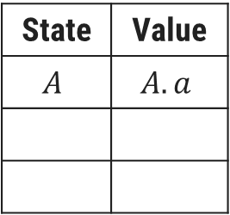
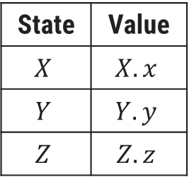
Bottom up evaluation of S-attributed definitions
S-attributed definition is one such class of syntax directed definition with synthesized attributes only.
Synthesized attributes can be evaluated using bottom up parser only.
Synthesized attributes on the parser stack
Consider the production A→XYZ and associated semantic action is A.a=f(X.x, Y.y, Z.z)
State | Value
$$X$$ | $$X.x$$
$$Y$$ | $$Y.y$$
$$Z$$ | $$Z.z$$
State | Value
$$A$$ | $$A.a$$
top-2
top
top-1
top
Before reduction
After reduction

Slide 21
Bottom up evaluation of S-attributed definitions
Production | Semantic rules
L → E_{n} | Print (val[top])
E → E₁+T | val[top]=val[top-2] + val[top]
E → T
T → T₁*F | val[top]=val[top-2] * val[top]
T → F
F → (E) | val[top]=val[top-2] - val[top]
F → digit
Input | State | Val | Production Used
3*5n | - | -
*5n | 3 | 3
*5n | F | 3 | F→digit
*5n | T | 3 | T→F
5n | T* | 3
n | T*5 | 3,5
n | T*F | 3,5 | F→digit
n | T | 15 | T→T₁*F
n | E | 15 | E→T
Implementation of a desk calculator with bottom up parser
 | En | 15
 | L | 15 | L → E_{n}
Move made by translator

Slide 22
L-Attributed definitions

Slide 23

L-Attributed definitions
A syntax directed definition is L-attributed if each inherited attribute of $Xj$, $1<=j<=n$, on the right side of $A→X1,X2…Xn$depends only on:
The attributes of the symbols $X1,X2,…X$_{j-1} to the left of $Xj$ in the production and
The inherited attribute of A.
Example:
Above syntax directed definition is not L-attributed because the inherited attribute Q.i of the grammar symbol Q depends on the attribute R.s of the grammar symbol to its right.
Production | Semantic Rules
A→ LM | L.i:=l(A.i) M.i=m(L.s) A.s=f(M.s)
A→ QR | R.i=r(A.i) Q.i=q(R.s) A.s=f(Q.s)
A→XYZ
Not L- Attributed
L- Attributed

Slide 24
Translation scheme

Slide 25
Bottom up evaluation of S-attributed definitions
Translation scheme is a context free grammar in which attributes are associated with the grammar symbols and semantic actions enclosed between braces { } are inserted within the right sides of productions.
Attributes are used to evaluate the expression along the process of parsing.
During the process of parsing the evaluation of attribute takes place by consulting the semantic action enclosed in { }.
A translation scheme generates the output by executing the semantic actions in an ordered manner.
This process uses the depth first traversal.

Slide 26
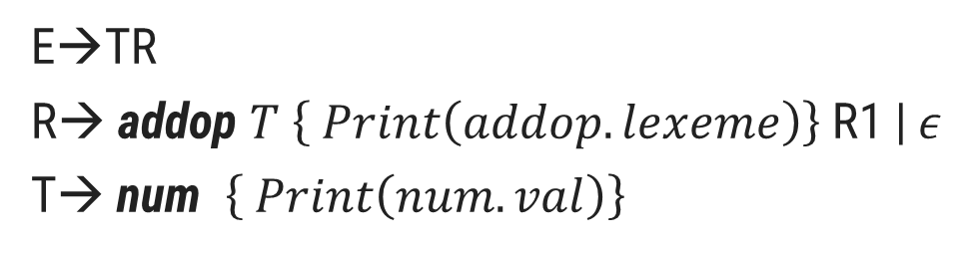
Example: Translation scheme (Infix to postfix notation)
String: 9-5+2
E→TR
R→ addop $T \left\{ Print\left(addop.lexeme\right)\right\}$R1 | 𝜖
T→ num $\left\{ Print\left(num.val\right)\right\}$
E
T
R
-
T
R
9
{Print(9)}
{Print(-)}
5
{Print(5)}
+
R
T
{Print(+)}
2
{Print(2)}
𝜖
Now, Perform Depth first traversal
Postfix=95-2+

Slide 27
Thank You

